Slide 1
Milk In Minutes Streamlining Dairy Product Orders
Mohammad Rayhan
Date-: 22-02-2024

Slide 2

Introduction
Dairy products have been a part and parcel of human life for centuries, serving as a reliable source of nutrition, sustenance, and culinary diversity.
The dairy shops have started offering options to the customers to order starting from farm fresh milk to dairy products to ice creams & lassi, organic products like paneer and ghee.
In addition, taking advantage of the widely used digital platform, the dairy products outlets offer options to customers to place their orders online.
The outlets can reach a larger audience, and the customers can enjoy the varieties of products prepared by the popular outlet, served at their doorstep.

Slide 3
Problem Statements (Angular)
Design Landing View
The landing view of the app must display the images of various dairy products. This view must be the default view. The landing view must also allow users to search/filter these items by their preference.
Design Order View
The view should display the details of the item selected. The details should include the item details as well as the customer details. The details should be persisted, and the customer should be acknowledged after the order is successfully placed.
Design Login View
The user should be navigated to the login view if he attempts navigation to the dairy-products- order view. The view should request the user to enter the security code to login as Administrator.
Design Dairy-Products-Requests View
This view will display all the dairy products order requests received in tabular format.

Slide 4
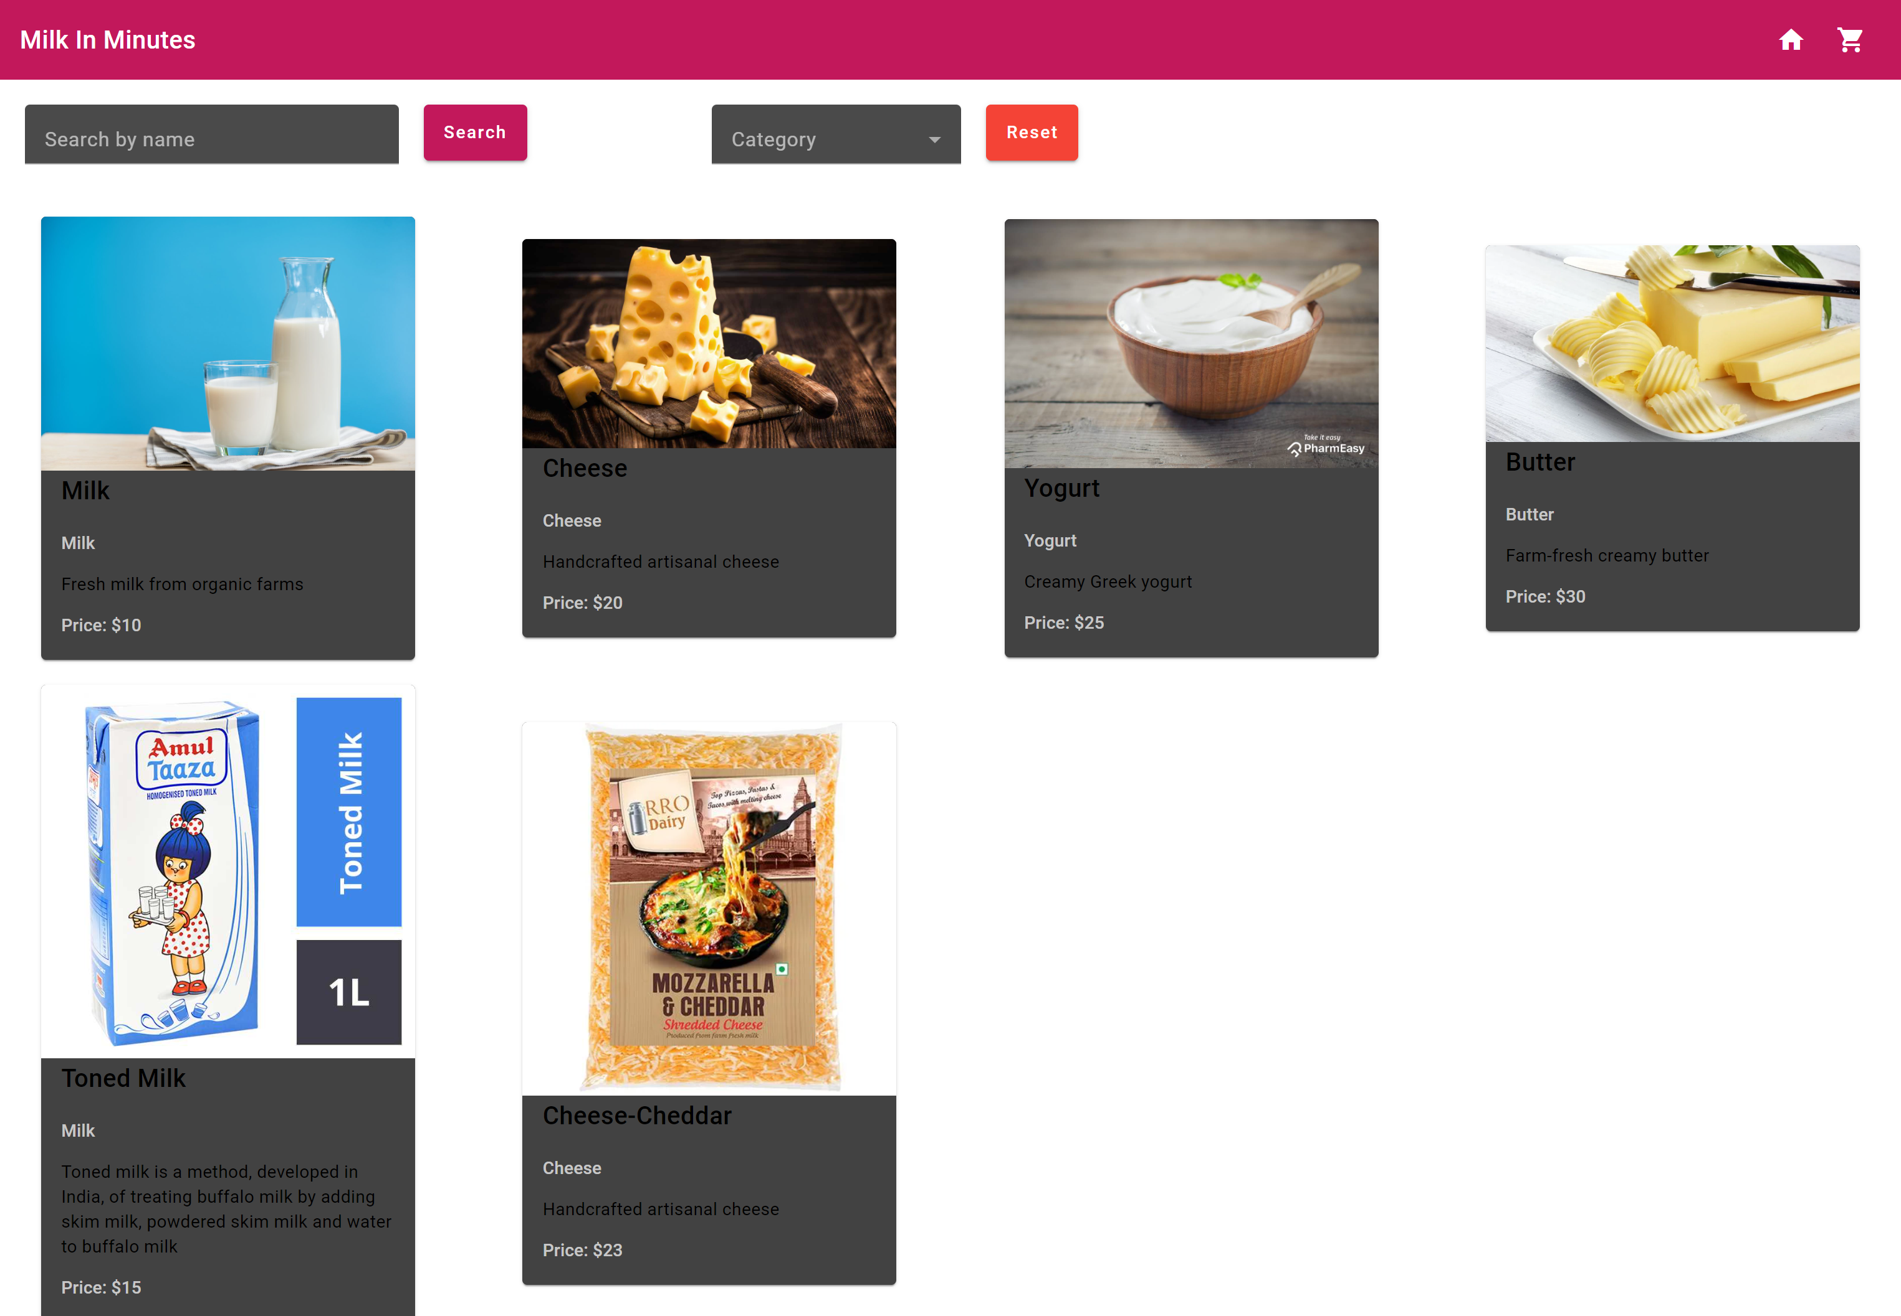
01
Landing View

Slide 5
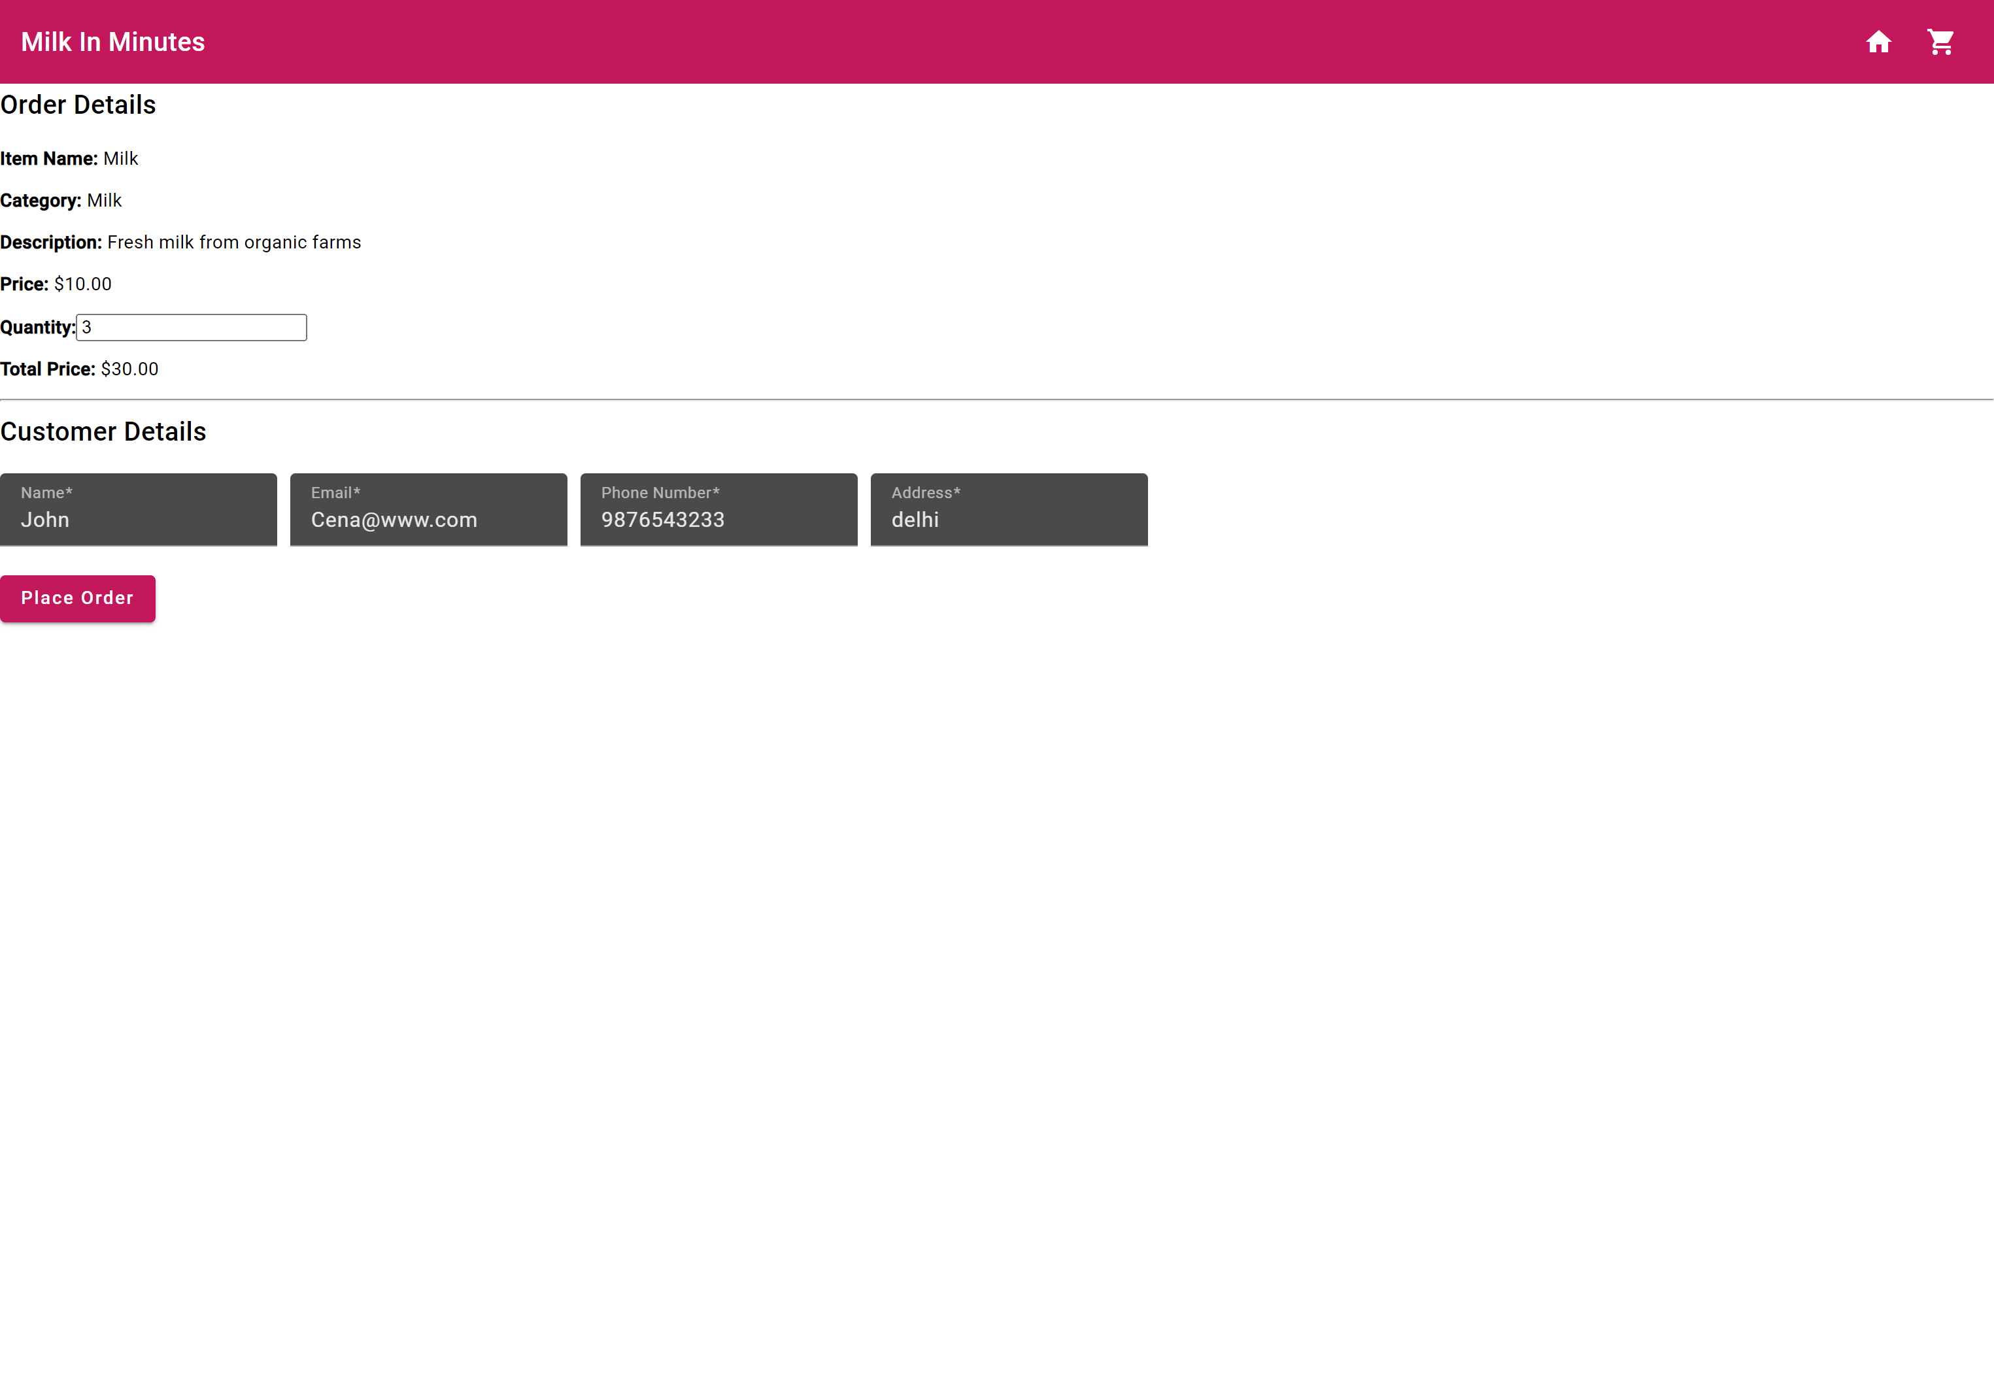
02
Order View

Slide 6
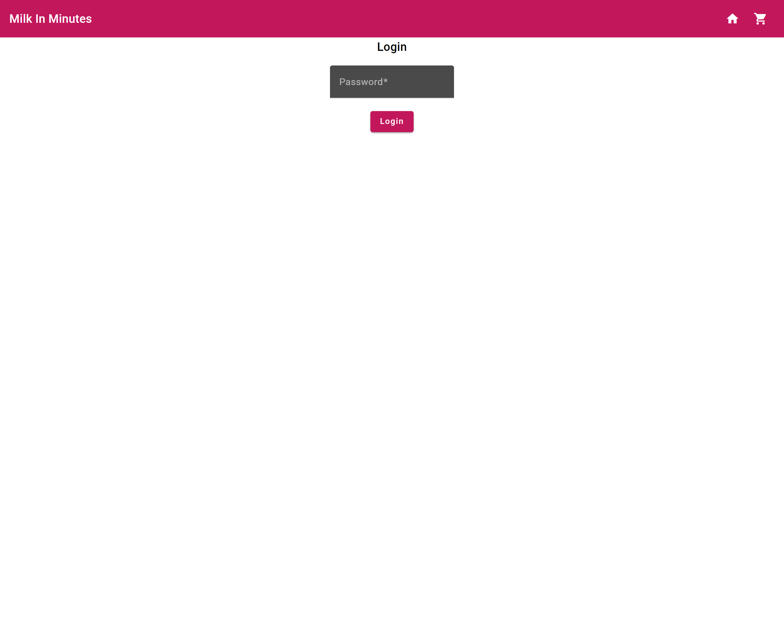
03
Login View

Slide 7
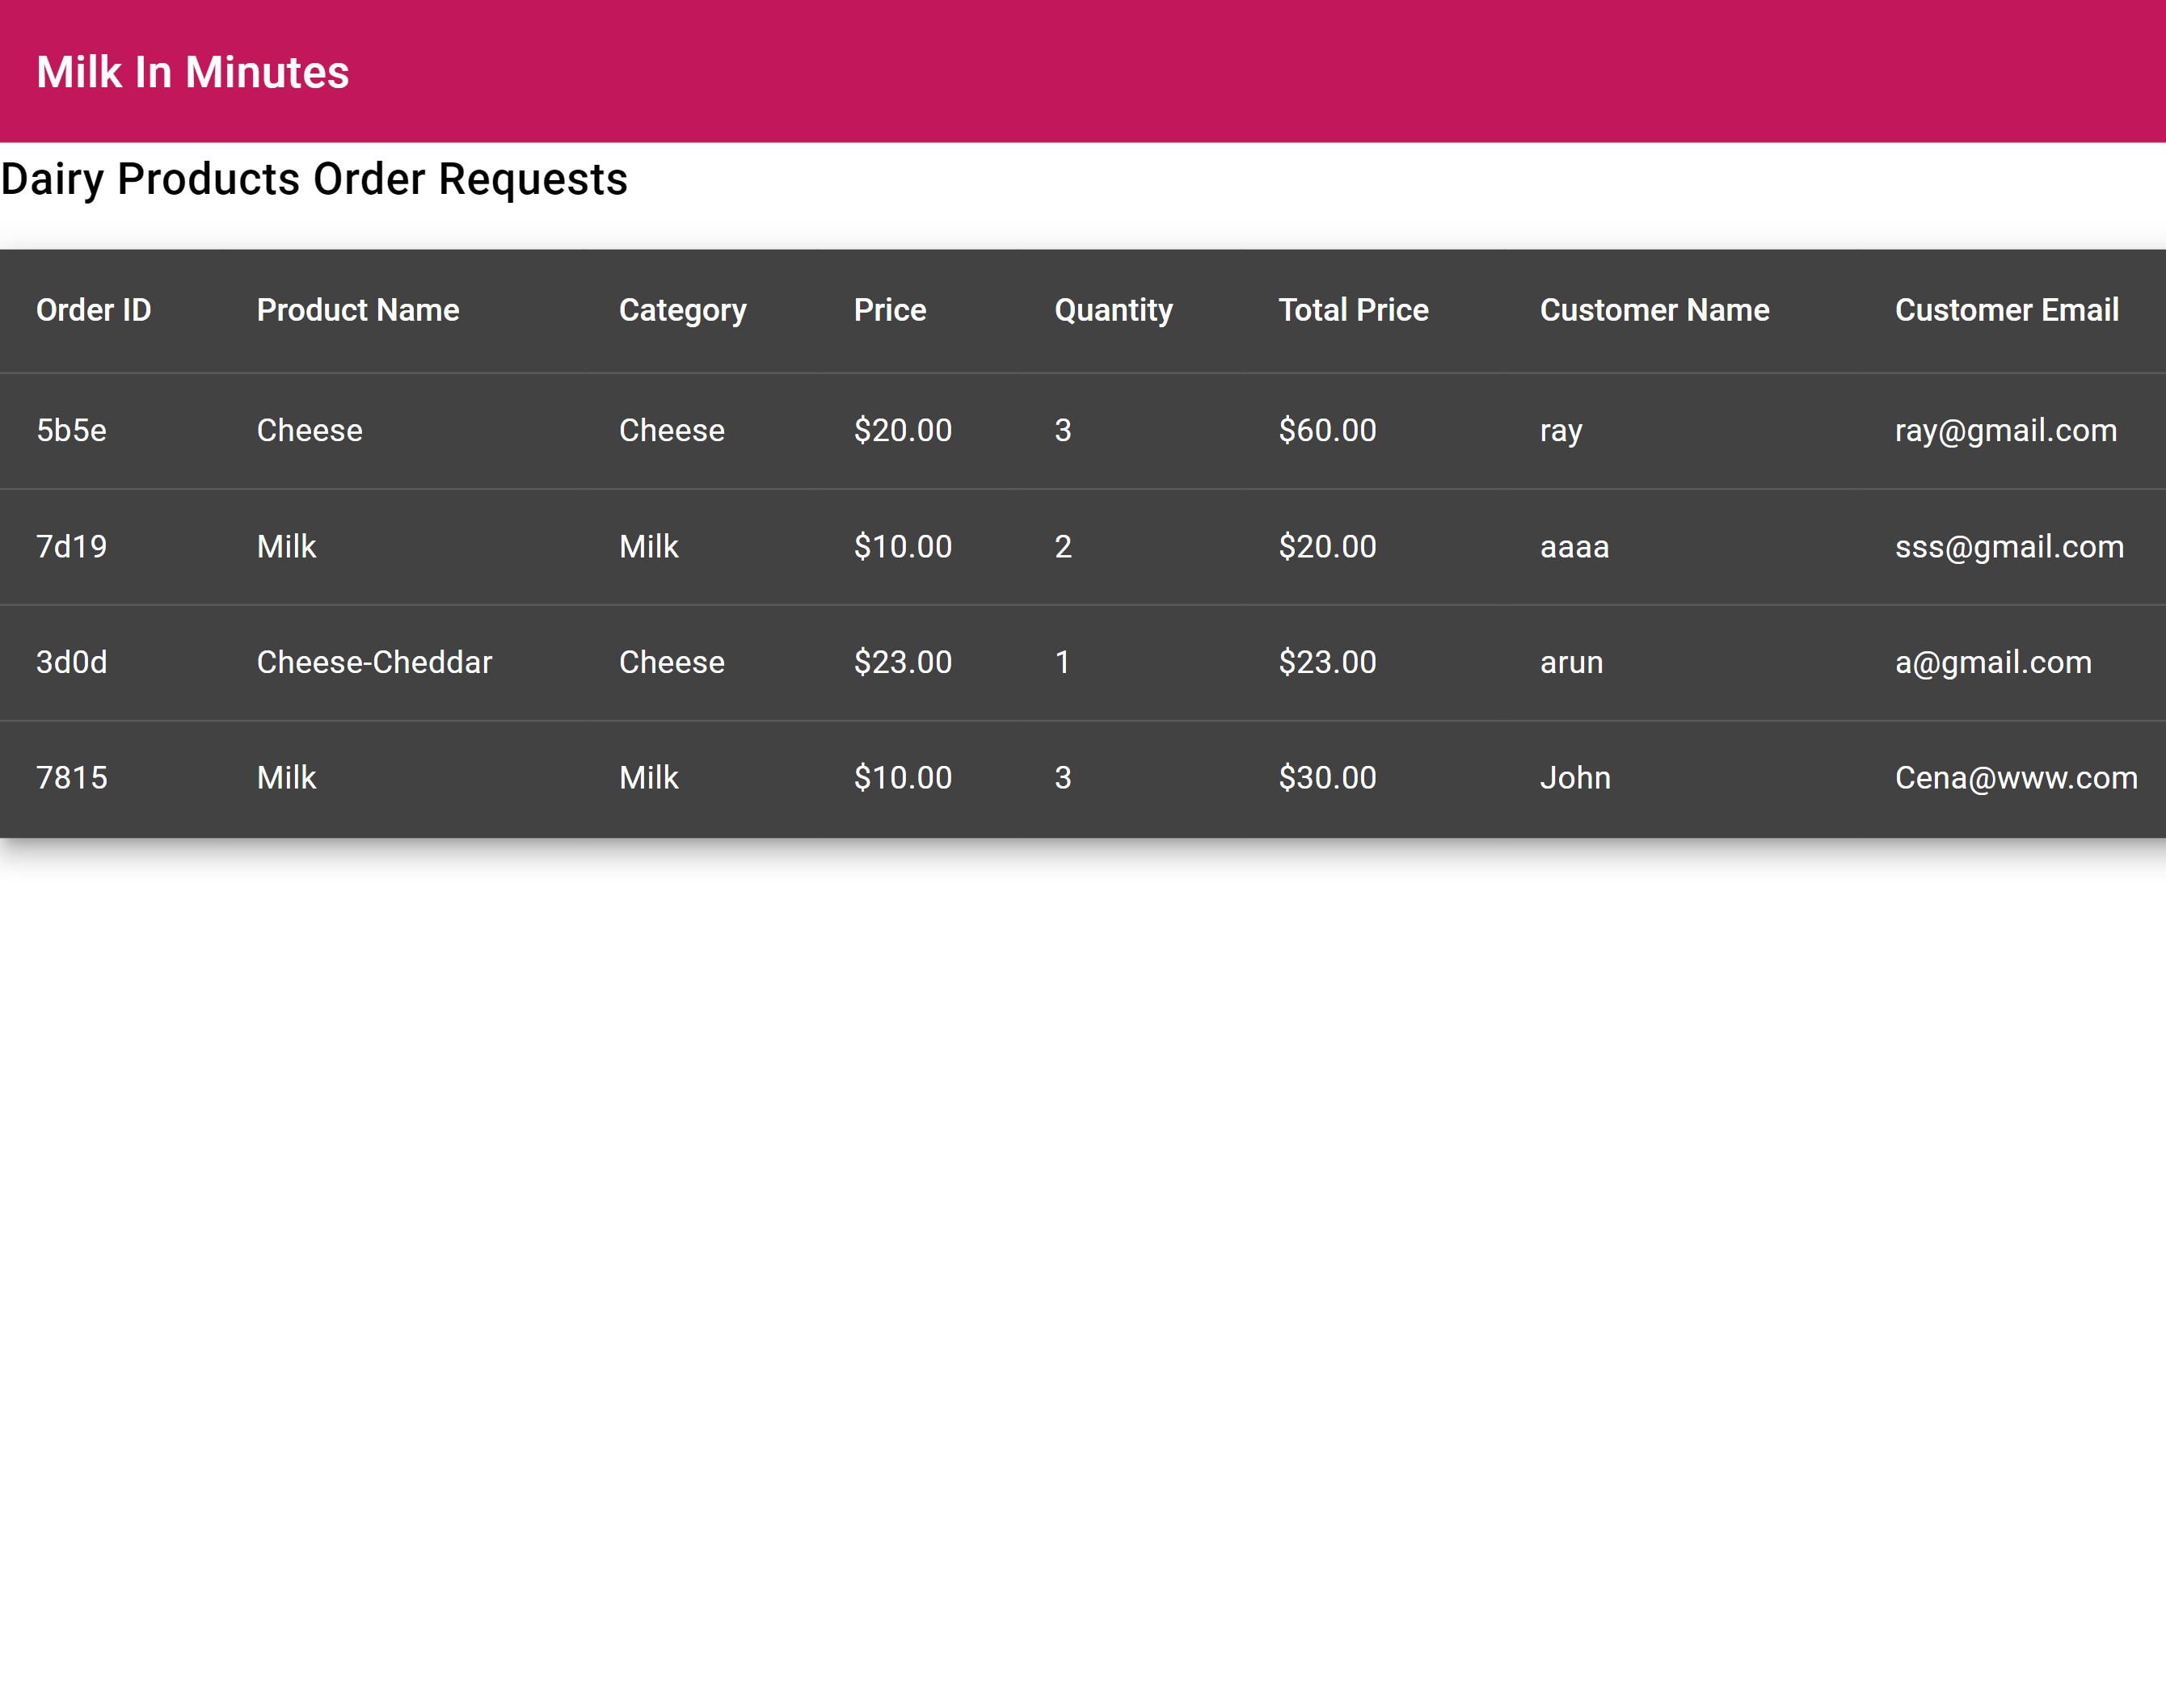
04
Order Request View

Slide 8

Prompts(ChatGPT):Landing View
Set up an Angular project using angular material.
Create components for the landing view.
Fetch data using json-server and display dairy product images and details.
Implement search/filter functionality for dairy products.
Make dairy products selectable, navigating users to the order view upon selection.
create a service to fetch data from json-server
define paths in app-routing.module.ts
Create a service to fetch the dairy product data
Utilize Angular Material components for UI elements to ensure a consistent and modern design.
Implement routing using Angular Router to navigate between views.

Slide 9
Prompts(ChatGPT):Order View
Create components for the order view.
Display details of the selected dairy product.
Allow users to provide order details, including item and customer details.
Persist order details.
Provide acknowledgment to the customer after a successful order placement.
Implement confirmation prompt if the user tries to leave the view without submitting the order.

Slide 10
Prompts(ChatGPT):Login View
Create components for the login view.
Prompt the user to enter a security code to log in as an administrator.
Implement validation for the security code.
Navigate the user to the dairy-products-requests view upon successful validation.

Slide 11
Prompts(ChatGPT): Dairy-Products-Requests View
Create components for the dairy-products-requests view.
Display dairy product order requests in a tabular format.
Implement restricted access for the site administrator.
Ensure only authenticated users can access this view.

Slide 12

Technolgies Used:
VS Code
Angular
Angular material
Json-server

Slide 13
Conclusion
Summary of the Presentation
Milk In Minutes has been presented as an innovative solution to streamline the process of ordering dairy products.
Through the implementation of Angular, json-server, and intuitive design, Milk In Minutes offers a user-friendly experience for both customers and administrators.
Benefits of Milk In Minutes for Customers and Administrators
Customers: Enjoy a seamless ordering experience with a visually appealing interface showcasing a variety of dairy products. Quick search and filter options facilitate efficient selection. Confirmation prompts ensure accurate orders, while timely acknowledgments provide peace of mind.
Administrators: Gain access to a dedicated view to manage incoming orders securely. The login feature ensures restricted access, enhancing data security. The tabular display of order requests simplifies tracking and processing, optimizing administrative tasks.

Slide 14
Thanks

